Slide 1
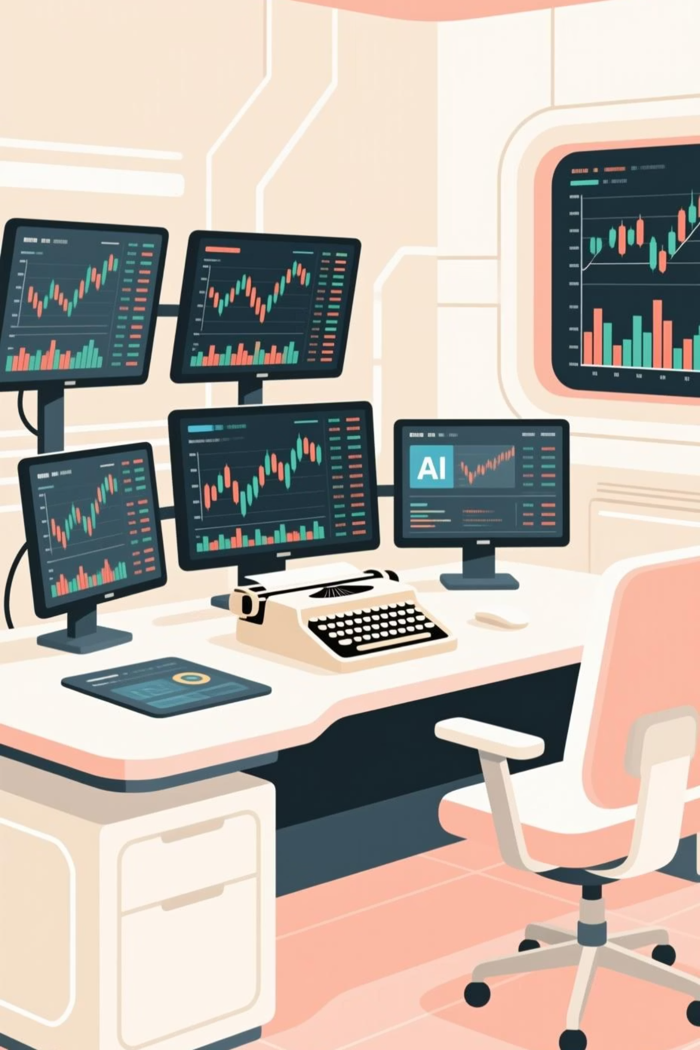
AI-Powered Trading Research & Analysis Chatbot
Real-Time Market Insights Using TA, FA, Strategy Ranking & RAG-Based AI
Saransh Bhargava 220379
Shruti Bajpayee 220576
Anshul Yadav 220643
Mentor: Dr. Satyendr Singh

Slide 2
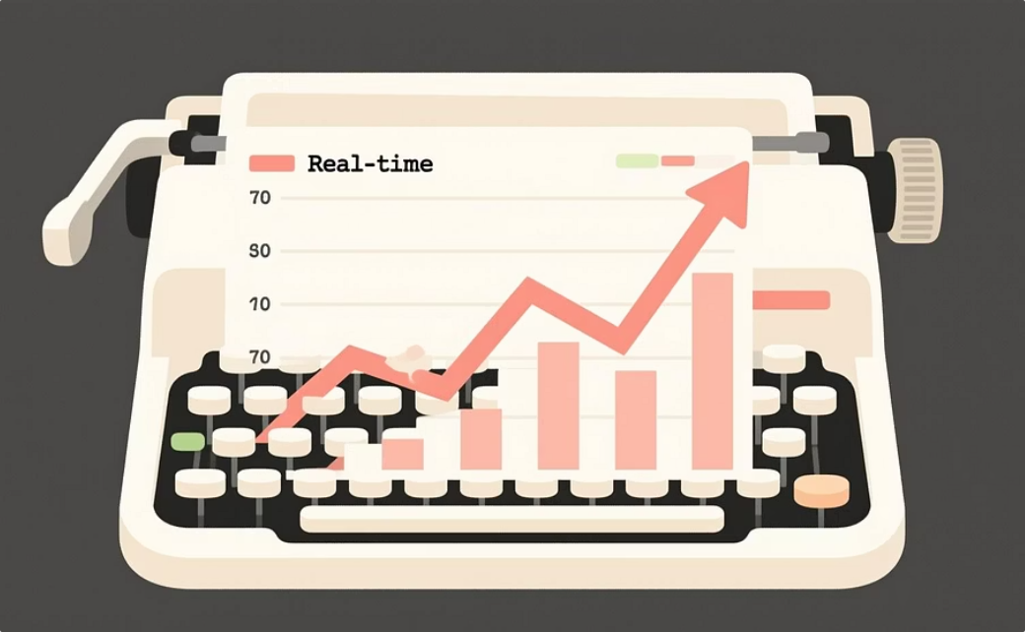
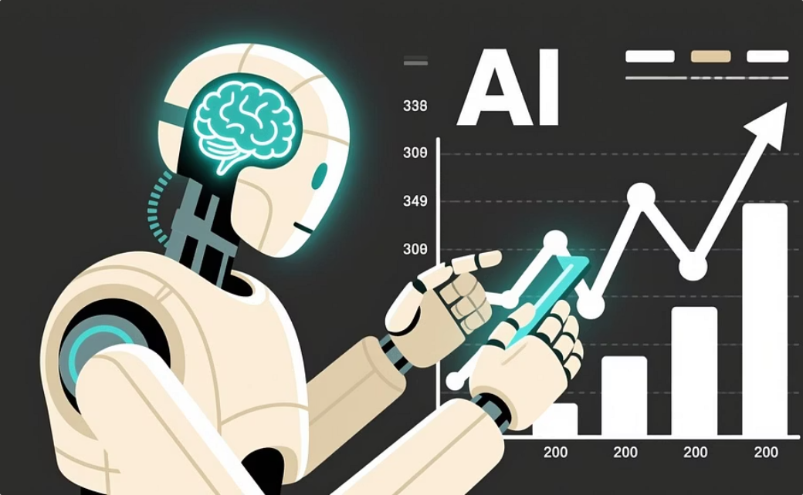

Introduction
This project is a comprehensive full-stack trading research system crafted to empower users with a deeper understanding of stock behavior. It meticulously integrates real-time market data, advanced technical indicators, crucial fundamental metrics, sophisticated strategy logic, and AI-driven explanations for unparalleled market insights.
Real-Time Data
AI-Driven Insights
Integrated Platform
Harnessing live market feeds to provide up-to-the-minute stock information.
Leveraging artificial intelligence for intelligent analysis and clear, educational explanations.
A unified solution combining React for the frontend and FastAPI for the backend for seamless interaction.

Slide 3
Problem Statement
Retail traders often face significant hurdles due to a lack of specialized technical knowledge, challenges in interpreting complex financial metrics, the proliferation of inconsistent information sources, and the absence of structured, actionable explanations. This project directly addresses these critical issues.
Lack of Technical Knowledge
Difficulty Reading Financial Metrics
Many traders lack the in-depth understanding required for effective market analysis.
Interpreting fundamental data and complex financial ratios can be daunting.
Inconsistent Information
Absence of Structured Explanations
Navigating a multitude of unreliable and often contradictory financial news and data sources.
A need for clear, coherent, and actionable reasoning behind market movements and strategies.
Our platform resolves these pain points by consolidating real-time data, comprehensive analysis, and AI-powered explanations into a single, user-friendly interface.

Slide 4
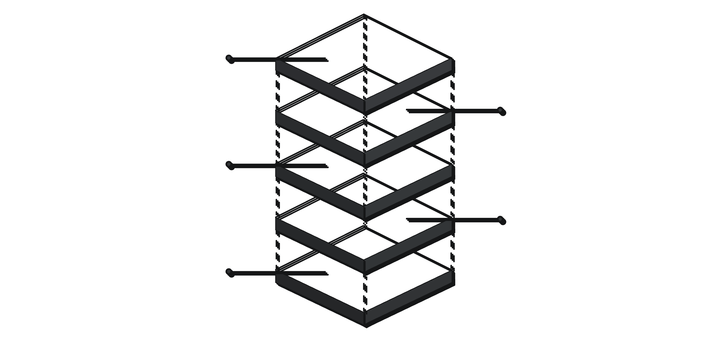
System Architecture
The system is meticulously designed with a robust architecture, ensuring seamless data flow and intelligent processing. It integrates several key components to deliver a powerful trading research experience.
AI Explanation
RAG-based layer producing explanations
Strategy Ranking
Evaluate and rank trading strategies
Data & Engines
Polling, caching, technical and fundamental
FastAPI Backend
API layer handling requests and sockets
React UI
Interactive frontend with WebSockets
This architecture facilitates the efficient acquisition, processing, and interpretation of market data, culminating in AI-driven insights delivered dynamically to the user.

Slide 5
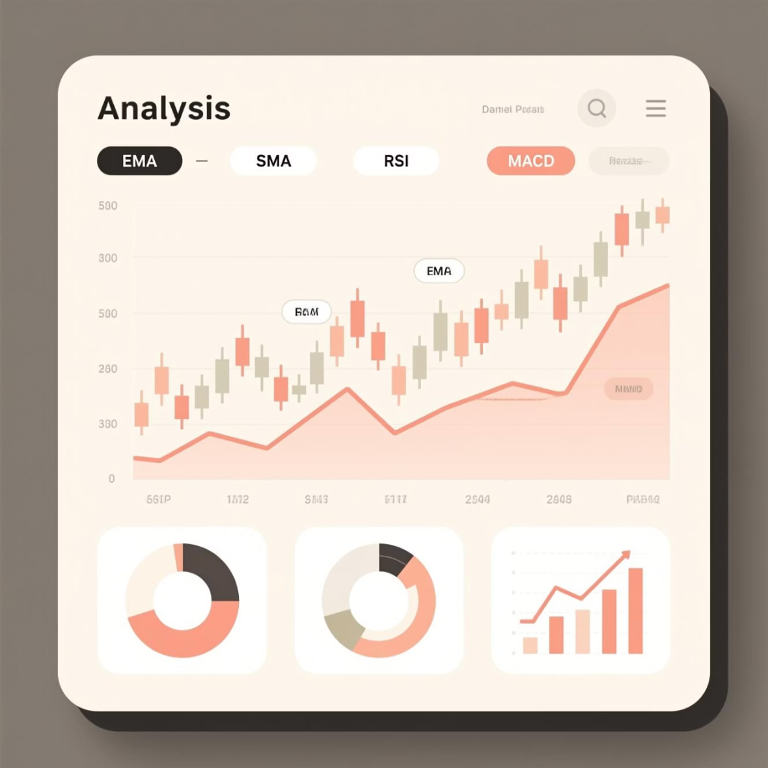
Technical Analysis Engine (TA)
The Technical Analysis (TA) engine is the backbone for understanding price movements. It processes historical Open-High-Low-Close-Volume (OHLCV) data to compute a wide array of indicators and detect crucial price patterns.
1
2
Indicator Computation
Pattern Detection
Calculates key indicators like Exponential Moving Average (EMA), Simple Moving Average (SMA), Relative Strength Index (RSI), Moving Average Convergence Divergence (MACD), and Average True Range (ATR).
Identifies significant price patterns, including breakout formations and double-top/bottom reversal patterns.
3
Signal Generation
Generates actionable technical signals that are vital for guiding subsequent strategy evaluations.
This engine provides the foundational technical insights necessary for informed trading decisions and strategy development.

Slide 6

Fundamental Analysis Engine (FA)
The Fundamental Analysis (FA) engine delves into a company's financial health to assess its intrinsic value. It systematically extracts and processes critical financial ratios and growth metrics.
Ratio Extraction
1
Extracts key financial ratios such as Return on Equity (ROE), Price-to-Earnings (PE), and Debt-to-Equity.
2
Multi-Year Growth Analysis
Evaluates growth trends over multiple years to identify sustainable business expansion.
3
Normalization & Weighting
Normalizes and applies weighted averages to metrics for a balanced assessment.
4
Composite FA Score
Aggregates individual metrics into a comprehensive Fundamental Analysis score.
Based on predefined threshold logic, the engine automatically identifies and highlights both the strengths and potential risks associated with a company's financial standing, providing a crucial perspective beyond just price action.

Slide 7


Strategy Ranking Engine
The Strategy Ranking Engine acts as the intelligent core, synthesizing the outputs from both Technical (TA) and Fundamental Analysis (FA) to evaluate and rank various trading strategies. It provides actionable recommendations for entry, stop-loss, and target levels.
Strategy Evaluation
Level Computation
Assesses the viability of strategies like Breakout, Swing, and Intraday based on combined TA/FA insights.
Calculates precise entry, stop-loss, and target levels utilizing ATR and EMA logic for risk management.
Optimal Selection
Ranks all evaluated strategies to identify and recommend the most suitable one for current market conditions.
This engine transforms raw data and analysis into concrete, actionable trading plans, streamlining the decision-making process for users.

Slide 8
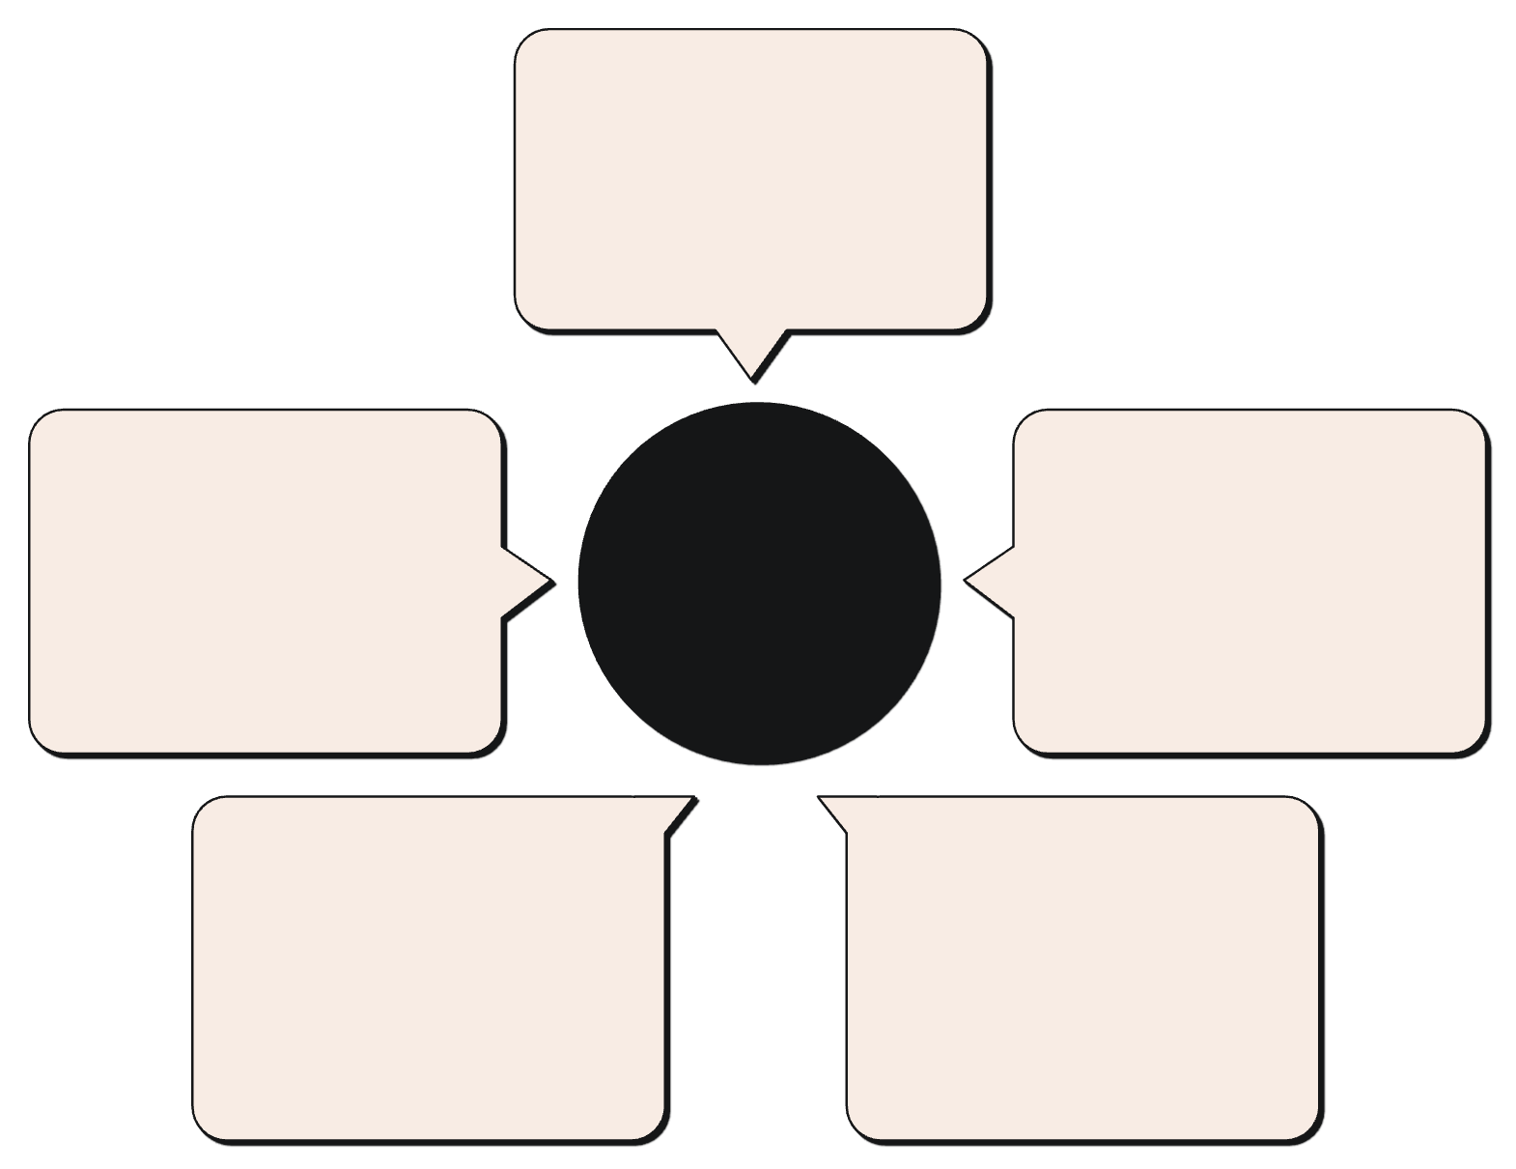
RAG-Based AI Assistant
Our RAG (Retrieval-Augmented Generation) pipeline ensures that the AI assistant delivers contextually rich, safe, and educational explanations. It intelligently combines retrieved information with real-time analysis to formulate precise responses.
Relevant Document Retrieval
Fetch contextual market docs
Safe, Educational Explanations
RAG Pipeline for Trading Explanations
TA, FA, Strategy Results
User-focused, compliance-safe output
Technical and fundamental analysis
LLM (Large Language Model)
Structured Prompt Building
Generate informed responses
Combine sources into a prompt
The LLM generates explanations covering technical levels, fundamental insights, inherent risks, and comprehensive reasoning, ensuring users receive well-rounded and trustworthy information.

Slide 9

Results & Key Observations
The project's implementation yielded consistent and reliable results across all modules, validating the integrated approach to trading research and analysis.
Accurate Technical Indicators
Outputs for technical indicators were consistently accurate and aligned with established financial methodologies.
Correct Financial Metrics Extraction
The FA engine reliably extracted and processed financial metrics, providing a solid foundation for fundamental analysis.
Rational Strategy Ranking
Strategy ranking produced logical and actionable entry, stop-loss, and target levels, enhancing decision support.
Grounded AI Responses
Chatbot responses were well-grounded in data and highly educational, fostering user understanding.
Reliable Real-Time Data Stream
The WebSocket pipeline effectively streamed real-time prices, ensuring dynamic and up-to-date market information.
Smooth UI Performance
The user interface exhibited smooth performance with dynamic updates, offering an intuitive user experience.

Slide 10

Conclusion & Future Scope
Conclusion
Future Scope
The AI-Powered Trading Research & Analysis Chatbot successfully integrates complex financial analysis, cutting-edge AI, and robust software engineering into a unified, educational trading assistant. It stands as a testament to real-time analysis capabilities, explainable AI, and a resilient architectural design.
ML-based price prediction to anticipate market movements.
Full charting implementation for enhanced visual analysis.
Integration of news sentiment for a holistic market view.
Advanced portfolio analysis and personalized alert systems.
Thank You!
We invite any questions from the panel regarding this project.

